Slide 1
How low can you go?
Ed Nutting

Slide 2
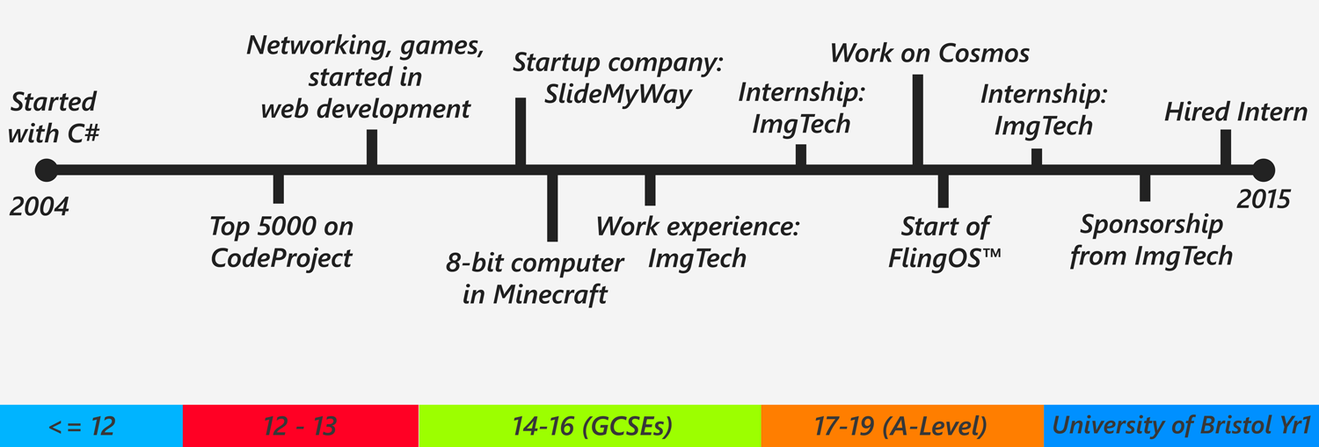
About

Slide 3
High vs Low level
What do I mean by “high” and “low” level?
Many varying definitions
My definition: Low-level is anything in kernel mode – drivers, core OS
Is there really much of a difference?
Fundamentally, yes.
Kernel level code has much more power
And much more theoretical complexity
Compare:
Simple high-level tasks: HTML/JS website, Scratch, Python scripts
Simple(?) low-level tasks: Basic bootcode, PWM control, Serial/UART

Slide 4
Current Situation
High level development is:
Growing
Well taught and understood
Accessible even for children
Increasingly abstracted
Increasingly vast
Creating high system complexity but low component complexity
Resulting in unstably weighted stacks of software
Low level development is:
Proportionally the same level of demand
Poorly taught (and often poorly understood)
Inaccessible even to advanced developers
Increasingly ignored by high level developers
Resulting in both wasted time/effort and significant software flaws

Slide 5
Example: Web app abstraction
Web app (HTML/JS/CSS)
Running inside a JS framework
Inside sandbox
Inside JS runtime
Inside web browser
Web browser itself may reside in a runtime (e.g. one written in Java)
Web browser sits on top of UM network/graphics drivers
On top of KM drivers
On top of the OS
On top of firmware
And finally the hardware

Slide 6
Side effects of abstraction
Totally untraceable
Complex call stacks and data paths
Lack of determinism
Lack of source code
External events/paths (e.g. network requests)
Impossible to guarantee:
Stability
Security
Unforeseeable circumstances
Who/what is going to have access to data?
What does it mean for IoT?
Attempts to put high-level systems on embedded devices (RPi)
Significant risk of creating many, simple devices in a large, unstable system

Slide 7
Example: Black Hat USA 2015 : Understanding and managing entropy usage
Bruce Potter & Sasha Wood"
“…cryptography is becoming…ubiquitous...”
“…algorithms are well understood, there are still numerous concerns…”
“…lack of quality random numbers can completely destroy the security provided by the underlying cryptosystem.”
Ignoring the technical detail, the main point was:
High level developers don’t understand low level crypto
So high level developers are implementing insecure systems
https://www.blackhat.com/us-15/briefings.html#understanding-and-managing-entropy-usage

Slide 8
Example: Monitoring web request packet sizes to detect user choices
Many web forms use mutli-selects or check-boxes
Results sent back often with name of option not number/index
If names have varying length, size of web request tells you which option was chosen
Is this a serious issue?
Suppose you’re filling out a medical form online?
Highly likely to have multi-choice
Can it be detected?
Yes, easily
So why is this a big problem?
Part of the wider “lack of understanding” / “lack of common knowledge” issue

Slide 9
Are people noticing?
Sort-of
IoT causing dramatic increase in demand
Increasing awareness of security
Other factors:
Speed / performance : Web levels of abstraction = huge power and speed loss
WebASM
JavaScript AOT compilation
Power consumption
Training / knowledge

Slide 10
Where’s it all headed?
To disaster? Globally, probably not.
Cannot continue to increase abstraction
Stripping back layers to bring things closer to native again
But retaining flexibility and ease of development
IoT is putting pressure on low-level developers
Too few developers
Existing developers being required to produce high-level-esk products
Features/tools of high level being brought into low level
UK industry is teetering on edge of a cliff
And UK teaching isn’t responding quickly or properly

Slide 11
Lack of developers
Ignoring general shortage across all areas of the industry…
Significant lack of low-level developers
Proportionally huge supply of high level developers
Over investment in web apps / web startups
Yet another bubble?
Under investment in low level technologies
Still dealing with repercussions of IPv4
Serious questions about sustainability of network growth
Little focus on low-level in education
University of Bristol: 1 computer architecture module in 1st year, no OS module, no follow-up modules till 3rd year at which point they’re optional!
Pretty much every University is in the same situation!
New CS curriculum in primary/secondary?

Slide 12
Education: Primary/Secondary
Heavy focus on high-level tech
Even the RPi is done in Python, Java or similar on top of Linux
BBC Microbit is closer but uses a high-level language and hides most of the genuine low-level (i.e. moderately complex) parts
Perfectly possible to teach this to teenagers!
Best evidence? I’ve done it.
Taught myself
Taught fellow students at my secondary school
Requirement on students: Intermediate coding knowledge (Attained in years 2 to 8)
Requirement on teachers: Knowledge and enthusiasm (Both are lacking!)

Slide 13
Example: (New) National Curriculum
Extract from https://www.gov.uk/government/publications/national-curriculum-in-england-computing-programmes-of-study/national-curriculum-in-england-computing-programmes-of-study
KS3:
understand simple Boolean logic [for example, AND, OR and NOT] and some of its uses in circuits and programming; understand how numbers can be represented in binary, and be able to carry out simple operations on binary numbers [for example, binary addition, and conversion between binary and decimal]
understand the hardware and software components that make up computer systems, and how they communicate with one another and with other systems
understand how instructions are stored and executed within a computer system; understand how data of various types (including text, sounds and pictures) can be represented and manipulated digitally, in the form of binary digits

Slide 14
Education: University
Computer architecture / low level topics often perceived as the hardest
Closely linked to compilers and hardware
But taught separately!
Hardware is often only covered by CSE / EE courses and not any in CS!
Compilers taught totally independently – no cross linking of topics
Little to no follow-through modules
Little to no emphasis on why low level understanding is important
And/or useful!
Wide perception that high level dev is the only worthwhile career path

Slide 15
Tackling the problems
Stop trying to mollycoddle students
Let them wreck some hardware with bad software
Let them hack (in both senses of the word)
Introduce low-level ideas in a more relevant context : IoT
Start teaching practical low-level/OS dev not just theory!
Most computer architecture and OS stuff is never actually implemented by students
Hands-on development makes it easier to understand / visualise
Hands-on makes it interesting and students can extend their work
Start pointing out the links between high and low level

Slide 16
What already exists
Some University courses
Columbia University
Stanford University
Software:
Minix? Largely dead as an educational aid now
Linux? If you fancy it (but most academics don’t like it, neither do I)
Others?
Hardware:
MIPS FPGA (Imagination Technologies)
Raspberry Pi (ARM),
Microbit (BBC)
Websites:
OSDev.org,
OSDever.net,
JamesMolloy.co.uk,
littleosbook.github.io
Books
These are increasingly problematic

Slide 17
An alternative approach
Teach from high to low
Stop presenting low-level as a separate / totally new thing
Use high-level languages and concepts as introduction
Move into C/C++ later on / alongside
Increases interest and relevance
Decreases barriers / makes it easier for students
Allows C (and ASM and compilers) to be taught alongside

Slide 18
Reactions to this approach
“An excellent idea to my mind. …, this seems like a great way to bridge the gap.”
“Innovative, unique and forward thinking. We’re looking into this for next year.”
“Excellent idea!”

Slide 19
What has FlingOS™ created?
That approach
C# kernel: Open source, microkernel, some drivers, AOT compiler (for MSIL)
Learn by example
30 articles: Free, online
Learn by reading
Practical approach to the subject matter
Covering history, reasoning/thinking, hardware, software, further reading
10 tutorials: Free, on YouTube
Learn by watching/listening
Takes you from just programming to having a (very) basic OS
No one part to be taken in isolation

Slide 20
What is FlingOS™ currently doing?
Lectures & Workshops
Teaching basic, practical OS dev
x86 and MIPS
10 undergrads
10 MSc students
Great reaction from students!
Supported by University of Bristol EE and CS departments
Further development & writing

Slide 21
Where is FlingOS™ headed?
Aiming to create a complete, accessible lecture course
Aiming to reach more students (A-level and University)
Aiming to reach more industry
Growing our articles and codebase
Raising sponsorship for next year
5 interns for 12 weeks
Target: £20,000

Slide 22
How can you help…
…yourself?
Use the resources (i.e. self-teach)
Engage with low-level
Think about security / stability
Contribute to community (e.g. write your own blog, Outreach events, Codeclubs, FlingOS)
…others?
Encourage them
Get involved in outreach : CodeClubs, local schools, blogs, Universities (via societies)
Get your company involved:
Sponsor communities, project and societies
Run hackathons (e.g. via Meetup.com) to engage people
…FlingOS?
Get in touch!
Always looking for help
Looking for sponsors – we have strong ties with the University, students and the wider online community

Slide 23
Thank you
Ed Nutting
Personal : edwardnutting@outlook.com
FlingOS™ : contact@flingos.co.uk
BEEES (Bristol Electronic & Electrical Engineering Society) : Social-secretary@beees.co.uk
www.flingos.co.uk

